Slide 1


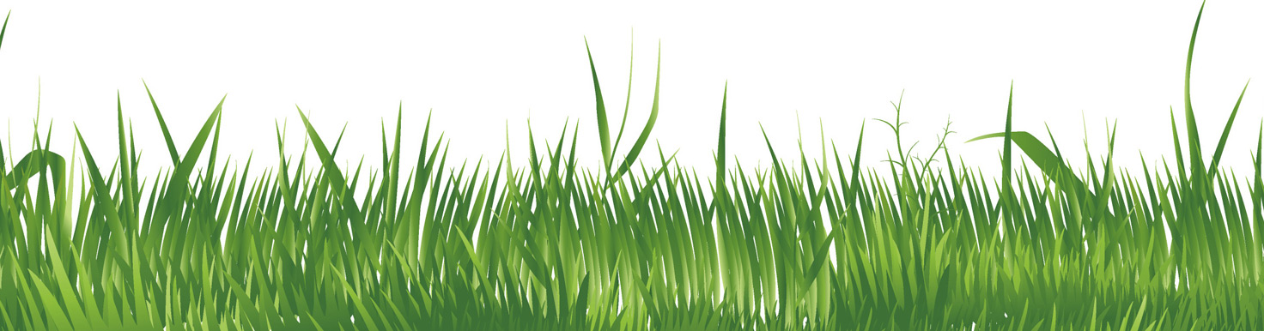

Linen in the
Lagan Valley
From flax to fabric
www.laganvalleylearning.co.uk

Slide 2
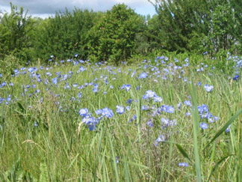
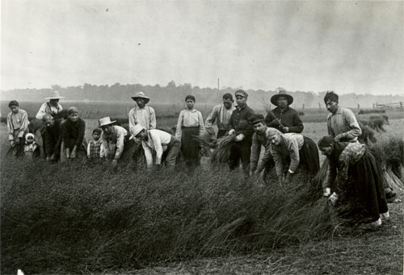
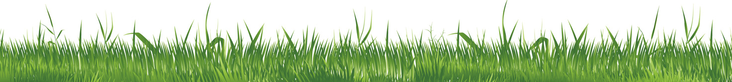
From flax to fabric
Linen comes from the flax plant. Flax is a tall plant, with blue flowers and long fibers which make it easy to spin into thread. Flax was sown in spring, usually around April
Local farmers would have grown the flax plant. Then they have would harvested the crop in August by pulling it from the ground by the root.

Slide 3
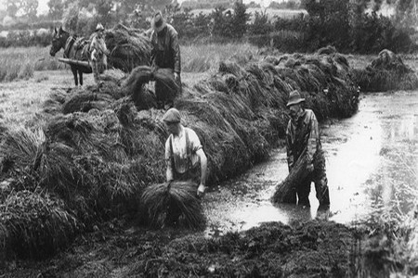
Retting
Bundles of flax were put into a pond or slow moving river for retting (rotting). After two weeks the stems would have been soft and they would have been taken out and dried.
How could they have stopped the stalk bundles from floating away?
        They were weighted down, usually with stones or wood.
        Why would retting time have to be carefully judged?
        Under-retting made separating the stalks difficult, and over-retting weakened the fibre.

Slide 4
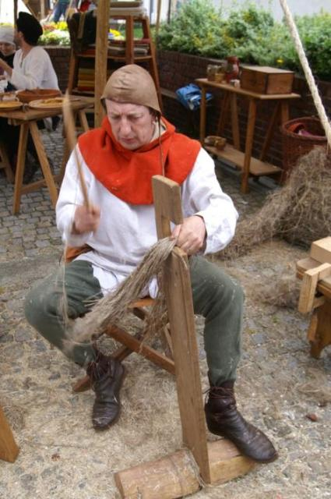
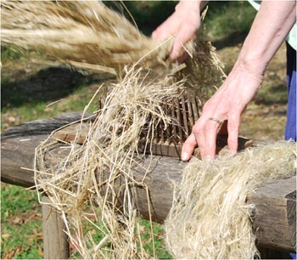
Dressing the flax
Dressing the flax is the term given to removing the straw from the fibres.
Scutching
A flat broad wooden knife was then used for ‘scutching’. This removed the outer skin and the inner parts and left the fibres.
Hackling
Next, the fibres were hackled or combed to untangle them.

Slide 5
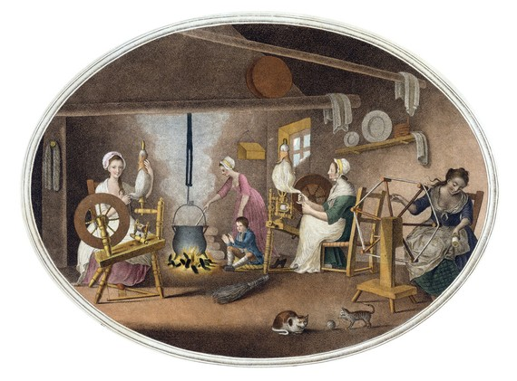
Spinning
The fibres were then taken and wrapped around each other during spinning to make strong linen yarn.
All these tasks would have been considered women’s work. They would attach ribbons to their wheels to show whether they were married or single!

Slide 6
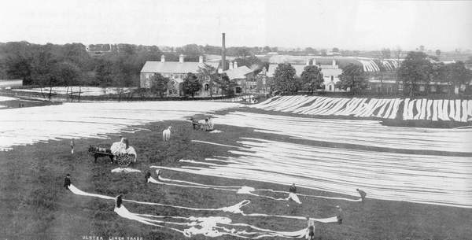
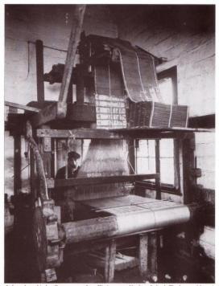
Bleaching and weaving
The cloth was bleached, this involved washing and boiling it. Then it was spread out on grass to be whitened by the sun. These areas were called ‘bleach greens’.
Many bleach greens had small watch towers where men could guard the cloth. In spite of this sometimes the linen was robbed!
Linen was then woven into cloth on a machine called a loom.
The final process ‘beetling’, involved using a machine to beat the surface of the cloth to make it shiny and smooth.

Slide 7
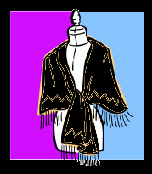
Jobs in the mill
Hacklers
The hacklers drew the flax fibres through rows of pointed pins to clean and split the fibres. Up until the start of the 20th century, the hacklers wore long-tailed coats, high hats and linen waistcoats. This dress showed their status as they were very highly skilled.
Spinners
In the spinning room, there was a process called wet spinning: there was always water and heat. They stood in bare feet in the water all day and frequently suffered from conditions such as ‘foot rot’.
The spinners wore black shawls known as “black clouds”.
Spinning Master
He was an authoritative figure who ultimately had responsibility for the running of the spinning room.

Slide 8
Doffers
“Doffing” was the first job most women did in the spinning room. The doffers replaced empty spinning “bobbins” with yarn.
Doffing mistress
The “Doffing Mistress” made sure that the doffers were doing their jobs quickly. She blew a whistle to tell the doffers to change the bobbins. Each spinner might have 80 – 120 bobbins to be replaced at once.
Half-timers
In 1901 the school leaving age was raised to 13. Many children had started work much younger. The “half-timers” were children that spent half their time in the mills and half in the schools. Some children worked for three quarters of the day in the mill and still spent half the day in school so their timetable might have looked something like the following:
6 am – 9 am working in the mill
9 am –3 pm in school
3 pm – 6 pm working in the mill

Slide 9
Weavers
The weavers worked in the “weaving sheds” in the factories. Learning to weave took approximately eight weeks.
The environment was so noisy that the weavers communicated by signing.
The “shuttle” was what the weavers used to fire across the loom with the thread. The big danger in the weaver’s sheds was one of the shuttles flying off.
The weavers would have worn a stiff white apron. They took great pride in their work and were paid weekly for the number of pieces they had produced.
Tenters
looked after the looms, and lit the gas jets needed to keep the factory warm and damp.

Slide 10



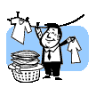

What kind of things are made from linen?
furnishings
sailcloth
bandages
fabric
threads
towelling
clothing
artist’s canvas
fishing nets
paper
medicines
Why is it used?
durable
absorbent
Because it’s…
dirt resistant
strong
cool in hot temperatures

Slide 11
www.laganvalleylearning.co.uk

